Slide 1
Introduction to PolicyCenter
5 April 2011
Notes:
Introduction to PolicyCenter - <number>
Guidewire training materials contain Guidewire proprietary information that is subject to confidentiality and non-disclosure agreements. You agree to use the information in this manual solely for the purpose of training to implement Guidewire software solutions. You also agree not to disclose the information in this manual to third parties or copy this manual without prior written consent from Guidewire. Guidewire training may be given only by Guidewire employees or certified Guidewire partners under the appropriate agreement with Guidewire.

Slide 2
Lesson objectives
By the end of this lesson, you should be able to:
  Describe the value proposition of PolicyCenter
  Describe the PolicyCenter product architecture
  Describe the tools commonly used and tasks commonly accomplished by technical developers during a PolicyCenter implementation
  This lesson uses the notes section for additional explanation and information.
  To view the notes in PowerPoint, choose View→Normal or View→Notes Page.
  If you choose to print the notes for the lesson, be sure to select “Print hidden slides.”
Notes:
Introduction to PolicyCenter - <number>

Slide 3
Lesson outline
PolicyCenter
PolicyCenter product architecture
PolicyCenter implementation tasks
Documentation and support
Notes:
Introduction to PolicyCenter - <number>

Slide 4
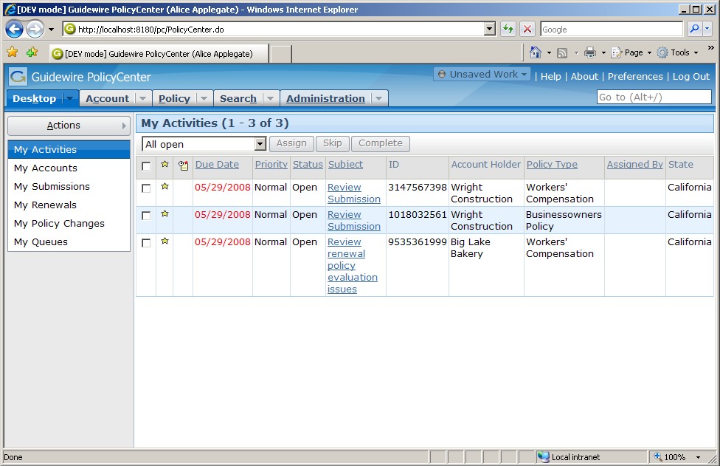
PolicyCenter
producer
underwriter
supervisor
Browser-based application
Supports multiple types of users, such as:
  Producers (who refer accounts to carrier)
  Underwriters (who create and manage policies)
  Supervisors (who supervise users and approve work)
Notes:
Introduction to PolicyCenter - <number>
PolicyCenter (PC) is a browser-based application that enables multiple users to participate in policy processing.

Slide 5

Value proposition of PolicyCenter
PolicyCenter makes the processing of policies:
insured
contacts
locations
forms
payments
trans-
actions
risk
analysis
product
model
  Policy-centric
  Collaborative
  Configurable
Notes:
Introduction to PolicyCenter - <number>
PolicyCenter is a policy-centric solution. All of the data pertaining to a policy is centralized in the policy file. This includes information on the insured, the policy locations, the payment history, any recorded risk analysis (such as previous claims filed), the product model used to build the policy, policy transactions for the policy (such as submissions, changes, and renewals), endorsement forms, and contacts. All users have an integrated and holistic view of the policy.
PolicyCenter facilitates collaboration among policy workers by providing one centralized location where all information needed to process the policy can be uniformly worked on and shared.
PolicyCenter provides a wide span of configuration options. The base application provides a robust starting point, but carriers can make changes as needed to the data model, the user interface, the business rules, and the product model.

Slide 6
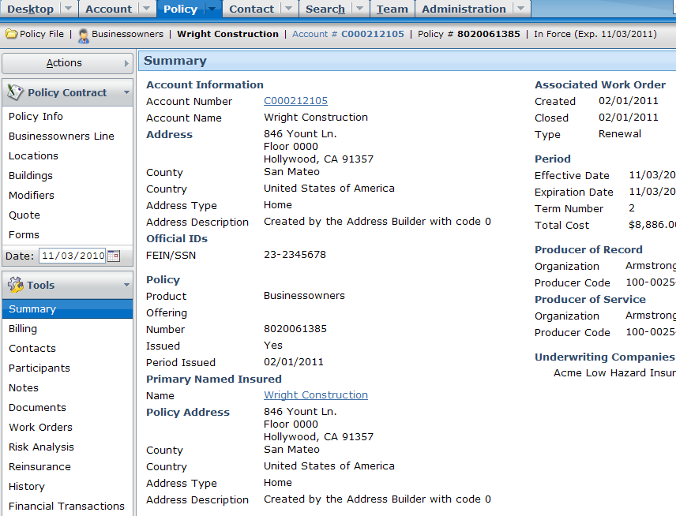
PolicyCenter is policy-centric
PolicyCenter is policy-centric solution
  All data pertaining to a policy is centralized in policy file
Notes:
Introduction to PolicyCenter - <number>
The screenshot above shows the policy file for a policy. Notice all the page links running down the left side of the screenshot. Each one represents a set of information about the policy which can be viewed by clicking the link.

Slide 7
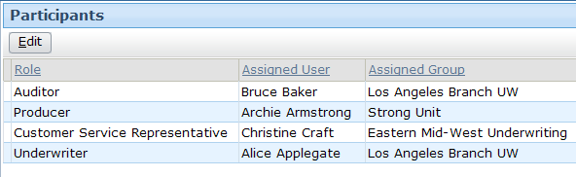
PolicyCenter is collaborative
Bruce
Baker
Archie
Armstrong
Christine
Craft
Alice
Applegate
One centralized location for all information about a given policy for every user
Notes:
Introduction to PolicyCenter - <number>
The policy shown above has a team of four people, each with various roles and responsibilities on the policy. For the policy shown above:
Alice Applegate is the underwriter for the policy.
Archie Armstrong is the producer for the policy.
Christine Craft is the customer service representative for the policy.
Bruce Baker is the auditor for the policy.

Slide 8
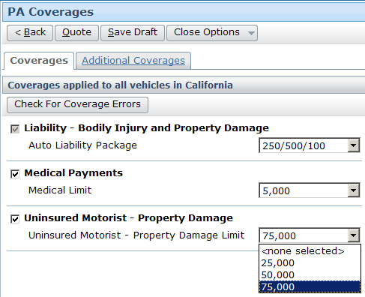

PolicyCenter is configurable
Make
Med Pay required in California
Add under-insured
coverage
Remove 25,000 limit
Add 100,000 limit
Notes:
Introduction to PolicyCenter - <number>
PolicyCenter is configurable. The base application provides a robust starting point, but carriers can make changes as needed to:
The entities in the data model, their relationships, and the information stored in each entity.
Any aspect of the user interface, including labels, fields, buttons, tabs, and screens.
The business logic, which controls issues such as role assignment, policy validation, and transaction processing.
The Product Model, which defines the available products and the coverages within those products.

Slide 9

Guidewire InsuranceSuite
ContactManager
ClaimCenter
PolicyCenter
BillingCenter
Guidewire Platform
Notes:
Introduction to PolicyCenter - <number>
Guidewire offers a set of applications designed to help insurance companies efficiently expedite their policies, billing, and claim requirements
All the applications sit on top of a common platform
All the applications can operate standalone or optionally integrate with each other
PolicyCenter is an application designed to issue, modify, and maintain data about policies.
BillingCenter is an application designed to issue and track the premium payments for policies.
ClaimCenter is an application designed to manage the process of reporting, verifying, and making payments on claims against a policy.
ContactManager is an application designed to manage contact information about people of interest to multiple claims.
Integration between BillingCenter and PolicyCenter is common. Once a policy has been issued, information must be sent to BillingCenter so that bills for the premium can be issued. If bills have not been paid, this may affect whether a policy is renewed and if so how.
Integration between PolicyCenter and ClaimCenter is common. When a claim is filed, the claims process must know which policy it is associated to and whether or not the relevant coverage existed on the policy at the time the loss occurred. Furthermore, the number of claims filed may impact whether a policy is renewed and if so how.
There is no integration between BillingCenter and ClaimCenter. This is because the billing system is focused on premiums whereas the claim system is focused on indemnification, expense, and recovery payments.
There is also typically no integration between ContactManager and PolicyCenter or ContactManager and BillingCenter. This is because there isn't a need for a separate system to manage contact information shared across accounts. This information is already contained within BillingCenter and/or PolicyCenter.

Slide 10

Guidewire platform
ContactManager
Data
Model
User
Inter.
ClaimCenter
PolicyCenter
BillingCenter
Data
Model
User
Inter.
Data
Model
User
Inter.
Data
Model
User
Inter.
Bus.
Logic
Int.
APIs
Bus.
Logic
Int.
APIs
Bus.
Logic
Int.
APIs
Guidewire Platform,
with a common technology for configuring...
Data
Model
User
Interface
Business
Rules
Integration
APIs
Notes:
Introduction to PolicyCenter - <number>
The Guidewire platform includes four main areas of technology. There is one area for configuring:
The data model, which defines the structure of the data.
The user interface, which defines the forms and fields the end user interacts with.
The business rules, which define and enforce business logic.
The integration APIs, which connect a given application to external applications, such as a reporting system or check printing system.
Every application uses this common technology to define its own data model, user interface, business rules, and integration APIs. Each application is distinct, but every application shares common abilities and configuration techniques with all the other applications.

Slide 11

PolicyCenter-specific functionality
PolicyCenter
Product
Model
Job-
flow
UW Issues
Policy
Validation
ClaimCenter
BillingCenter
Data
Model
User
Inter.
Data
Model
User
Inter.
Data
Model
User
Inter.
Bus.
Rules
Int.
APIs
Bus.
Rules
Int.
APIs
Bus.
Rules
Int.
APIs
Guidewire Platform,
with a common technology for configuring...
Data
Model
User
Interface
Business
Rules
Integration
APIs
Notes:
Introduction to PolicyCenter - <number>
Each application has application-specific functionality. The application-specific functionality is created by implementations of the various platform-level technologies.
The PolicyCenter-specific functionality includes:
The Product Model, which defines products, the policy lines assigned to each product, the coverages and coverables for the product, and the coverage terms for those coverages.
Jobflow, which defines how policy transactions (such as submissions, renewals, changes, and cancellations) are executed.
Underwriting issues which are created when a condition evaluated, based on data entered on a policy in PolicyCenter, gives undesirable result(s). Only the Underwriter has the authority to approve those issues.
Policy validation, which validates that a given policy is valid, quotable, bindable, or issuable.

Slide 12
Lesson outline
PolicyCenter
PolicyCenter product architecture
PolicyCenter implementation tasks
Documentation and support
Notes:
Introduction to PolicyCenter - <number>

Slide 13
The application server
Supported application servers:
  IBM
  WebSphere 7.0.7 or greater
  Oracle WebLogic 11gR1
  (10.3.2 or greater)
  Apache
  Tomcat 6.0.18 or greater
  JBoss EAP 5.1.0
App. Server Computer
Java EE Application Server
Supported
operating
systems:
  Vendor-supported operating systems
    Refer to your application server vendor
    For Apache Tomcat, review the Platform Support Matrix
Notes:
Introduction to PolicyCenter - <number>
The information listed below is accurate as of PolicyCenter 7.0. For earlier or later releases of PolicyCenter, consult the Guidewire Supported Platforms Matrix.
All Guidewire applications, including PolicyCenter, are run within an application server. This is a robust piece of software that can run enterprise-wide applications. There are several different types of application servers. The type of application server used by Guidewire applications is a Java Enterprise Edition (Java EE) server. The platform was known as Java 2 Platform, Enterprise Edition or J2EE until the name was changed to Java EE in version 5. This type of application server is written to run on the Java 1.6 run-time environments.
The PolicyCenter application is built and deployed as an Web Application Archive (WAR) or Enterprise Application Archive (EAR) file to the application server. It contains all the configuration, operational data and data definition files necessary to execute the application.
PolicyCenter supports these Java EE server products:
IBM WebSphere Application Server 7.0.7 (or greater) Base
Oracle WebLogic 10.3.2 (or greater) Server
Apache Tomcat 6.0.18 or greater
JBoss EAP 5.1.0
The application server typically sits on a computer that is not dedicated to hosting any other aspects of the architecture, such as the database. This computer must use an operating system supported by your third party application server vendor (or Guidewire, in the case of Apache Tomcat.)
PolicyCenter supports the operating systems for which application servers provide customer support. For details, review the customer viewable document Guidewire Supported Platforms Matrix.
The PolicyCenter application (the center box) consists of a set of business rules, a user interface, a set of integration APIs, and a data model. The technology for configuring these application elements is platform-level (and common to all Guidewire applications), but the specific rules, UI, APIs, and data model for PolicyCenter is distinct.

Slide 14
Application database
App. Server Computer
J2EE Application Server
Supported RDBMS:
  Oracle
  11.2.0.2.x Enterprise
  Microsoft
  SQL Server 2008 R2 Enterprise
PC
Database
computer
Application DB
Notes:
Introduction to PolicyCenter - <number>
The information listed below is accurate as of PolicyCenter 7.0.0. For earlier or later releases of PolicyCenter, consult the product documentation.
A relational database is a series of data structure called tables which are linked (or related to) each other. The operational data for PolicyCenter is stored inside a relational database. This database is typically hosted on a machine separate than the machine hosting the J2EE application server.
The war file contains a file called config.xml which specifies which database to connect to and how to establish the connection.
PolicyCenter supports these relational database products:
Oracle 11.2.0.2.x Enterprise RDBMS
Microsoft SQL Server 2008 R2 Enterprise

Slide 15

User computers
App. Server Computer
Supported web browsers:
  Internet Explorer 7.0 or 8.0, with
  WinScriptHost 5.7 or higher
Java EE Application Server
User Computer
PC
Database
Computer
Application DB
Notes:
Introduction to PolicyCenter - <number>
The information listed below is accurate as of PolicyCenter 7.0.0. For earlier or later releases of PolicyCenter, consult the product documentation.
End users connect to PolicyCenter using a web browser. PolicyCenter generates a series of standard HTML pages that are rendered within the browser. PolicyCenter is a server-side application. It dynamically generates the HTML pages and data within those pages. It makes only a minimal use of functionality in the client (the web browser). Because there are no static HTML files, you cannot use the browser's Back button. All navigation is controlled on the server side by PolicyCenter.
PolicyCenter supports these web browsers:
Microsoft Internet Explorer 7.0 or 8.0
In a development environment, you do not have to stop the PolicyCenter application to deploy configuration changes to the business rules or the user interface. You must stop the PolicyCenter application to deploy configuration changes to the data model. You may or may not need to stop the PolicyCenter application to deploy configuration changes to integration APIs, depending on the nature of the change.
In a production environment, configuration changes are typically made be rebuilding and redeploying the application's WAR (web archive) file. This always involve stopping and restarting PolicyCenter.

Slide 16

External systems
Claims
Admin.
App. Server Computer
Java EE Application Server
Address
Book
User Computer
Authen-
tication
Billing Admin
Reporting
PC
Database
computer
Application DB
Notes:
Introduction to PolicyCenter - <number>
PolicyCenter is typically integrated with a number of external systems. The connections to these systems are configured through the application APIs. The most commonly integrated external systems are detailed on the next slide.

Slide 17
Common points of integration
External
System
Policy Processing
  Legacy policy admin.
  Document production
  Document storage
  Billing
Policy Pricing
  Rating
  ISO
  Credit rating
  Claims
User Management
  Authentication
  Managing General Agent
Miscellaneous
  Contact management
  Address normalization
  Reporting
Notes:
Introduction to PolicyCenter - <number>
A definition for each integration point appears below:
Legacy policy administration system - This external system maintains policies created prior to the implementation of PolicyCenter (or policies for which PolicyCenter is not the system of record but for which PolicyCenter needs information).
Document production system - This is an external system used to store document templates and create documents.
Document storage system - This is an external document storage system which is used for storage and document retrieval.
Billing system - This is an external billing system which sends bills to the insured (so that they pay the premium) and reports when accounts are overdue.
Rating engine - This is a system which is used to determine quotes and premiums for policies.
ISO - (This integration point is common only for American carriers.) This is an American company which maintains rating information for fire protection for every place in the United States. A city can have many fire protection classes, therefore the information is defined at the location/address level. ISO also maintains Building Code Effectiveness grades of how well any community enforces their building codes. This is used for fire, EQ and wind/storm rating.
Credit rating system - This is a system which maintains credit rating information about the insured, such as Dun and Bradstreet.
Claims system - This is the system that managed claims for the carrier and is relevant at renewal time to determine if the policy should be renewed and if the rates should be raised.
(continued)

Slide 18

(Notes only slide)
Notes:
Introduction to PolicyCenter - <number>
Authentication system - This system takes a user name and either a token or a password and verifies if the two match.
Managing General Agent (MGA) system - This system tracks either a person or company that is authorized by an insurance company to transact business. This typically includes the authority to bind the insurer, issue policies, authorize producing agents, perform administrative functions, and even adjust claims.
Contact management system - This is an integration point to an external address book application for managing contacts.
Address normalization service - This is an external service which verifies address validity (with regards to the existence of a street address, the appropriateness of a given postal code for a given city, and so on). In the United States, this information is promulgated by the United States Postal Service (USPS), which has standardized abbreviations (such as "ste" for suite and "ln" for lane) and a complete range of numeric addresses per street, streets and addresses per postal code, and postal code per state.
Reporting system - This system provides reports on PolicyCenter business and user data.

Slide 19
Lesson outline
PolicyCenter
PolicyCenter product architecture
PolicyCenter implementation tasks
Documentation and support
Notes:
Introduction to PolicyCenter - <number>

Slide 20


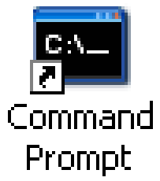
Implementer tools
Rules, UI, Typelists
Java EE Application Server
Other XML
XML file
Java
CSV
files
Developer
computer
Notes:
Introduction to PolicyCenter - <number>
Developers responsible for implementing PolicyCenter use a series of tools to configure the PolicyCenter base application to meet the needs of a given carrier. These include:
Guidewire Studio, which is an application used to configure most types of aspects of PolicyCenter such as the user interface, business rules, typelists, and the product model. Business rules are written in Gosu, which is Guidewire's proprietary scripting language while most of the other configurable resources are configured in XML.
A third-party XML editor such as Notepad ++ (freely available on the internet), XMLSpy or any editor capable of modifying XML, which is used to configure the resources for which Studio does not provide a specialized editor. This includes the data model, batch scheduling, application-wide configuration and security configuration, amongst others.
A third-party IDE such as Eclipse is used to write the Java code that implements application plug-ins or web services that enable external integration. The IDE often uses ANT, which is a tool for running ANT scripts that execute common application build tasks, such as building the application web archive file, copying changes from the development environment to the deployment environment, or regenerating the data dictionary.
Guidewire command-line utilities for managing tasks such as deploying configuration changes, executing scheduled tasks, or importing user data from comma-separated value (CSV) files into PolicyCenter .
A third-party source control system, which enables multiple developers to work on the same set of code by enforcing check-in/check-out and version control.

Slide 21
Common implementation tasks
Task | Studio | XML | Java IDE | Cmnd Prmpt (CSV file)
Configure the data model | X | X
Configure the user interface | X | X
Configure the business rules (Gosu) | X | X
Configure the product model | X
Configure the integration points | X |  | X
Configure global application behavior |  | X
Import business data (such as users and groups) |  |  |  | X
Import initial configuration data (such as roles + activity patterns) |  |  |  | X
Schedule and run batch processes |  | X |  | X
Create and backup the PC database | (through the RDBMS)
Notes:
Introduction to PolicyCenter - <number>
Configuring the data model centers around the creation of new entities, new subtypes, dropdown list values, and/or new fields within existing entities. Except for dropdown list values, which are configured using Studio's Typelist Editor, all data model configurations are done through XML files.
Configuring the user interface centers around the creation of new screens, the modification of existing screens, and the modification of navigation to screens, as well as Gosu functions used within the UI to provide dynamic behavior.
Configuring the business rules centers around the creation of rules for major automated tasks, such as assignment, validation, and transaction approval, as well as Gosu functions used within the rules.
XML editor can also be used to configure user interface since all PCFs are in xml format. Same goes for business rules. But doing it via Studio is easier and is recommended.
Configuration of the product model involves identifying the different types of policies, or products, that a given instance of PolicyCenter offers.
Configuring the integration points centers around the writing of Java plugins and adapters to connect to external systems.
Configuring global application behavior centers around specifying behaviors such as which days of the week are considered business days, the maximum number of quotes per submission, and the amount of time a user can be inactive before he or she is automatically logged off of PolicyCenter.
Importing business data centers around the importing of business data that may already exist in other systems or is otherwise not created directly within PolicyCenter. This could include an existing user and group structure.
(continued)

Slide 22
(Notes only slide)
Notes:
Introduction to PolicyCenter - <number>
Importing initial configuration data centers around importing data used by the application to execute basic functionality, such as sets of permissions that are assigned to users to denote their level of access, or patterns from which activities are generated.
Scheduling and running batch processes centers around the configuration of batch processes, such as checking for policies for which the renewal process should start.
RDBMS stands for Relational DataBase Management System.
Scheduling batch process is done via scheduler-config.xml, however they can be run explicitly via the command prompt too, using maintenance_tools –startprocess command.

Slide 23
Lesson outline
PolicyCenter
PolicyCenter product architecture
PolicyCenter implementation tasks
Documentation and support
Notes:
Introduction to PolicyCenter - <number>

Slide 24
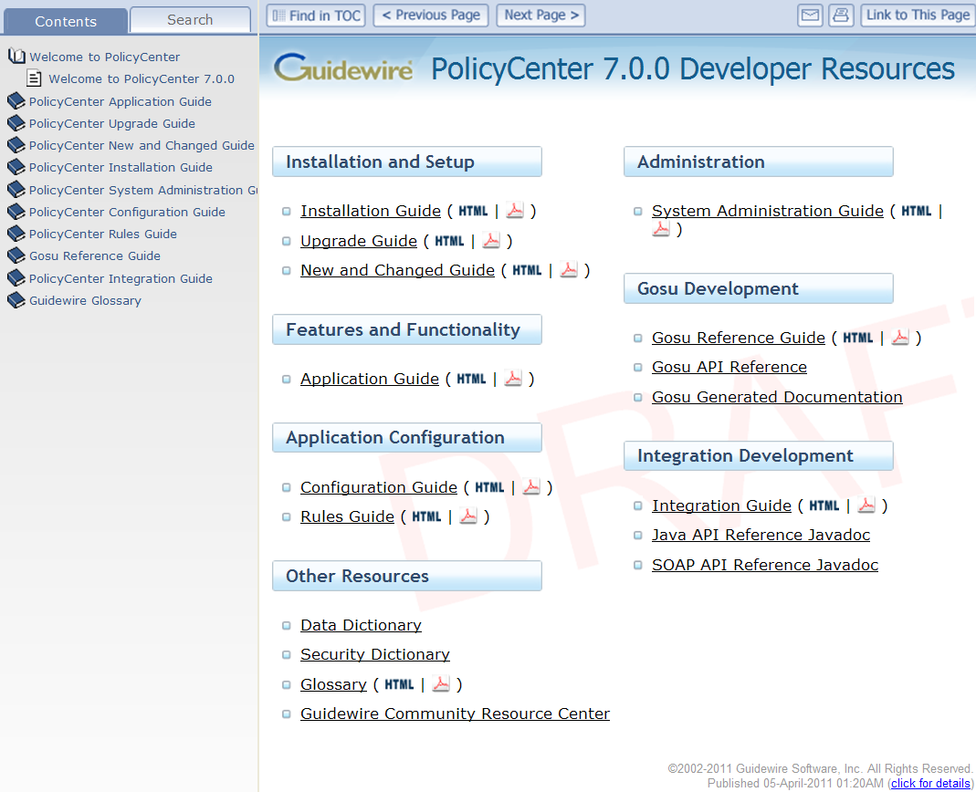
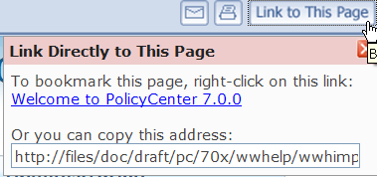
PolicyCenter Documentation Welcome page
Table of contents
Documentation set
Publication date
Notes:
Introduction to PolicyCenter - <number>
There are two types of PolicyCenter documentation that you can access from the PolicyCenter Welcome page:
Books that are immediately available in both HTML and PDF format
Dynamic documents that need to be generated
When you mouse-over the name of a document, a tooltip that describes the resource is displayed. For dynamic documents, the tooltip also provides instructions for generating the document.
Four tabs are provided for searching and navigating the documentation:
The Contents tab displays the table of contents for all books.
The Search tab allows you to perform a simple word search within the HTML documents. You can select a specific book or choose “All Available Books” to include in your search.
The following buttons are available:
“Find in TOC” displays the table of contents with the current topic highlighted.
“Previous Page” and “Next Page” help you navigate sequentially through a document. Note the difference in behavior between “Previous Page” and the back button in your browser: “Previous Page” takes you to the page that immediately precedes the current page whereas the back button redisplays the most recent page you visited.
E-mail opens a new email that includes a link to the current topic.
Print allows you to print the current page.
“Link to This Page” provides a URL for you to copy or bookmark in your browser.

Slide 25
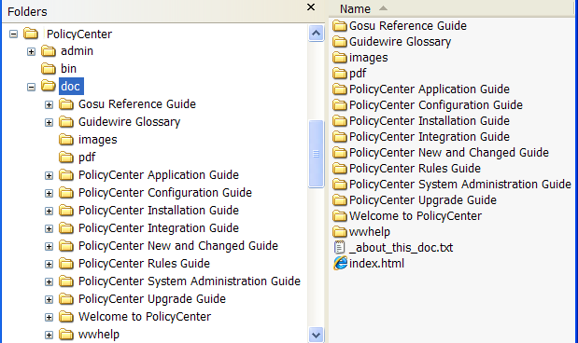
PolicyCenter Documentation
Available from <PolicyCenter home>\doc directory
API references are also available but must be generated
Documentation set in PDF
Always open this file to access full documentation set
Notes:
Introduction to PolicyCenter - <number>
PolicyCenter is shipped with a full set of documentation in both HTML and PDF formats. The recommended way to access the full documentation set is to open the main index.html. You can then bookmark the URL in your browser.
In addition, there are multiple references that describe the current state of your implementation, but they must be generated. These references are discussed in the "PolicyCenter Application Configuration" and "PolicyCenter Application Integration" courses.

Slide 26
Using the documentation
For this task … | Use …
Simple, whole-word search | Search tab to perform a search of all HTML books or of a single book
Comprehensive search | Open a PDF and use the Find facility
Print the current page | Click
Print multiple pages | Open the PDF and print selected pages
Send a link | Click
Bookmark a page in your browser | Click , right-click the link, and select Add to Favorites
Add an entry to the Favorites tab | On the Favorites tab, click Add button to create a link to the current page
Use these facilities for copying and bookmarking instead of using the URL in the address field
Notes:
Introduction to PolicyCenter - <number>
When bookmarking a page or copying the link to a page, do not use the URL in the address field of your browser. Depending on the version of the documentation, the browser URL points either to the root directory of the documentation or to a file name, which is subject to change when topics are added to the documentation. The URLs that are available when you click the E-mail and “Link to This Page” buttons include the topic name instead of the file name so are less likely to change when the documentation is updated. Be sure to use the correct link when sending comments or questions to Guidewire Customer Support.
A simple search facility is provided for HTML documents. This mechanism is especially useful for searching across all HTML documents, but it does not support the use of quotation marks, wild cards, or partial words. For a more comprehensive search, open the PDF version of the document and use the Find facility.
You can perform a cross-book search of the PDF documents but not from your browser :
Open Adobe Reader.
Choose Edit → Search.
Select “All PDF Documents in” and then select the directory that contains the PDF files, such as C:\PolicyCenter\doc\pdf.
Click Search.

Slide 27
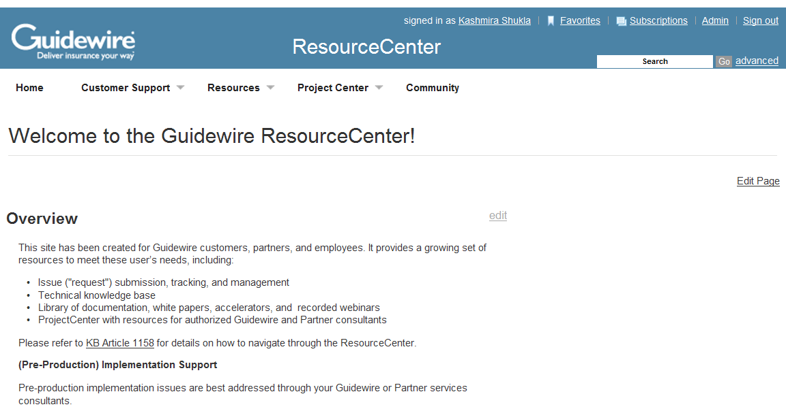
Guidewire ResourceCenter
The Guidewire ResourceCenter is a web site for support and information about Guidewire products
Notes:
Introduction to PolicyCenter - <number>
The ResourceCenter is at http://guidewire.hivelive.com/pages/home.
Accounts are automatically created for Guidewire employees and members of the customer implementation team.
The support and information functionality includes:
Issue management
Product documentation
Infrastructure and methodology white papers
Knowledge base
Implementation highlights
Company events
Users can create and update issues related to their project or organization. Customers can view and submit issues only once they are in production.

Slide 28
Lesson objectives review
You should now be able to:
  Describe the value proposition of PolicyCenter
  Describe the PolicyCenter product architecture
  Describe the tools commonly used and tasks commonly accomplished by technical developers during a PolicyCenter implementation
Notes:
Introduction to PolicyCenter - <number>

Slide 29
Review questions
App. Server Computer
User Computer
Java EE Application Server
What does
an end user need on his
or her machine to access PolicyCenter?
Name three external systems PolicyCenter is frequently integrated with.
What is stored in the application database?
pc
Application DB
Notes:
Introduction to PolicyCenter - <number>
Answers
1. Internet Explorer (7.0 or higher)
2. Possible answers: External policy administration system, rating engine, billing system, issuance system, reporting system.
3. The operational data for PolicyCenter, as well as application data that describes the types of entities used in the application, the fields on each entity, and so on.

Slide 30
Notices
Copyright © 2001-2011 Guidewire Software, Inc. All Rights Reserved.
Guidewire, Guidewire Software, Guidewire ClaimCenter, Guidewire PolicyCenter, Guidewire BillingCenter, Guidewire Reinsurance Management, Guidewire ContactManager, Guidewire Vendor Data Management, Guidewire Client Data Management, Guidewire InsuranceSuite, Guidewire ContactCenter, Guidewire Studio, Gosu, Deliver Insurance Your Way, and the Guidewire logo are trademarks or registered trademarks of Guidewire Software, Inc. in the United States and/or other countries.
This material is Guidewire proprietary and confidential. The contents of this material, including product architecture details and APIs, are considered confidential and are fully protected by customer licensing confidentiality agreements and signed Non-Disclosure Agreements (NDAs).
This file and the contents herein are the property of Guidewire Software, Inc. Use of this course material is restricted to students officially registered in this specific Guidewire-instructed course, or for other use expressly authorized by Guidewire. Replication or distribution of this course material in electronic, paper, or other format is prohibited without express permission from Guidewire.
    Guidewire products are protected by one or more of the following patents: U.S. Patent No. 7,885,831; U.S. Patent No. 7,788,296.
Notes:
Introduction to Guidewire Configuration - <number>

